Slide 1
Open vSwitch(OvS)
報告者 : 吳騰然

Slide 2
Outline
What is Open vSwitch (OvS)
OvS Architecture & Components
Demo

Slide 3
What is Open vSwitch (OvS)
Open vSwitch is a multilayer software switch licensed under the open source Apache 2 license.
Open vSwitch is well suited to function as a virtual switch in VM environments.
Open vSwitch supports multiple Linux-based virtualization technologies including Xen/XenServer, KVM, and VirtualBox.

Slide 4
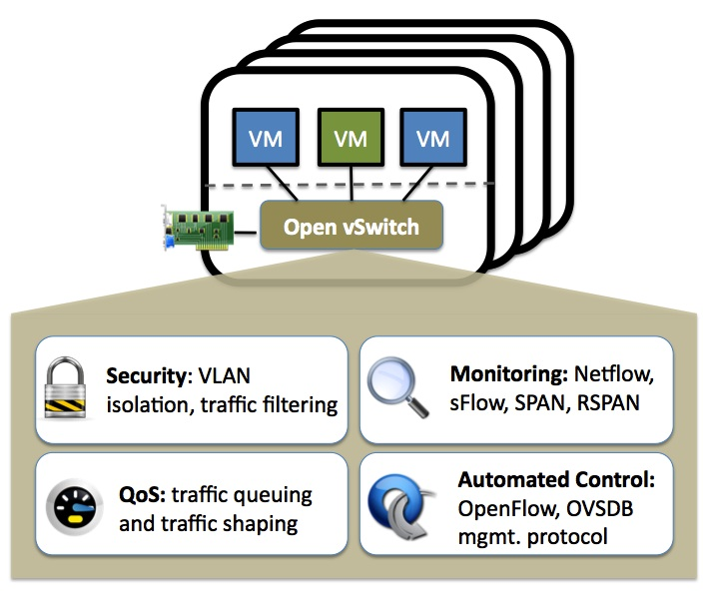
Open vSwitch (OvS) Features
The current release of Open vSwitch supports the following features :
Open vSwitch supports the following all features : https://www.openvswitch.org/features/

Slide 5
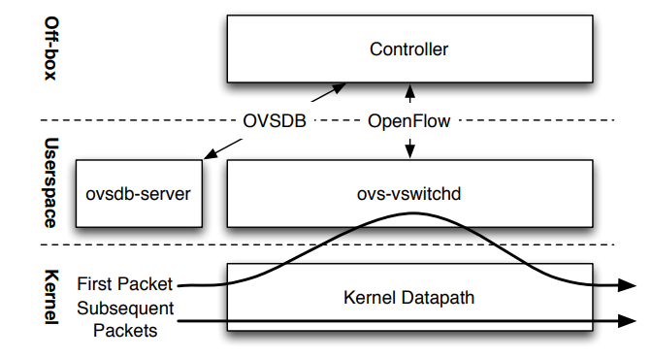
OvS Architecture
參考來源 : “The Design and Implementation of Open vSwitch” Figure 1

Slide 6
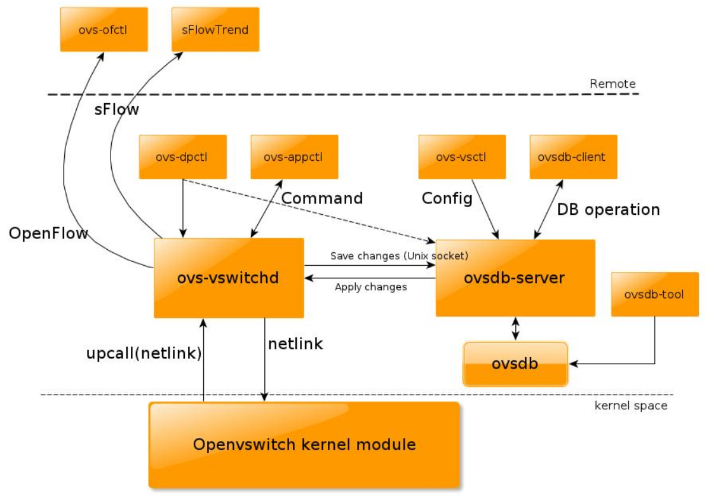
OvS Components
ovs-ofctl : 用來管理和監控 OpenFlow switches
ovs-appctl : 用來控制或詢問 Open vSwitch daemons
ovs-vsctl :查詢和更新 ovs-vswitchd 的配置
ovs-dpctl : 用來管理 Open vSwitch datapaths
ovs-vswitchd：Open vSwitch 最主要的 daemon
ovsdb-server：用來設定及操作 ovsdb 的 Server
ovsdb：Open vSwitch 的 Database

Slide 7
Demo
Demo :
  使用 OvS 來連線外部網路
  Vlan 實作
Install Open vSwitch :
  sudo apt -y install openvswitch-switch-dpdk

Slide 8
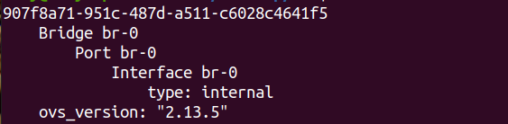
SetUp Bridge
sudo ovs-vsctl add-br br-0
  Bridge 可以想像成一個 switch
sudo ovs-vsctl show
enp0s3
IP Stack
br-0

Slide 9
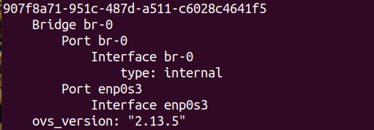
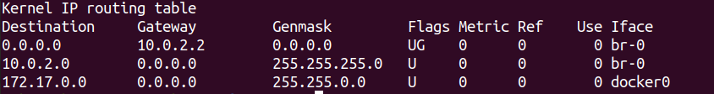
Network Interface Add OvS Port
sudo ovs-vsctl add-port br-0 enp0s3
  類似像實體的 switch 上的 port
ifconfig enp0s3 0 (Remove enp0s3)
dhclient br-0
route -n
enp0s3
IP Stack
br-0

Slide 10
Increase Container
Add two container :
  docker pull busybox
  docker run -itd --name=vm1 --cap-add=NET_ADMIN --net=none busybox /bin/sh
  docker run -itd --name=vm2 --cap-add=NET_ADMIN --net=none busybox /bin/sh
Use ovs-docker configure :
  sudo ovs-docker add-port br-0 eth0 vm1 --ipaddress=10.0.2.10/24
  sudo ovs-docker add-port br-0 eth0 vm2 --ipaddress=10.0.2.20/24
enp0s3
IP Stack
vm1
此時 vm1、vm2 目前網路還尚未成功
br-0
vm2

Slide 11

Insert Gateway
進入 vm1
  docker exec -it vm1 /bin/sh
  route –n
為 container 加入 gateway
  route add default gw 10.0.2.2
Ping "google.com" 測試

Slide 12
Vlan Demo
Demo Architecture
enp0s3
IP Stack
vm1
Vlan 100
vm2
Vlan 100
br-0
vm3
Vlan 200
vm4
Vlan 200

Slide 13
Increase Container
新增兩個 container
  docker run -itd --name=vm3 --cap-add=NET_ADMIN --net=none busybox /bin/sh
  docker run -itd --name=vm4 --cap-add=NET_ADMIN --net=none busybox /bin/sh
為 vm3、vm4 增加 port 和 ipaddress
  sudo ovs-docker add-port br-0 eth0 vm3 --ipaddress=10.0.2.30/24
  sudo ovs-docker add-port br-0 eth0 vm4 --ipaddress=10.0.2.40/24
為 vm3、vm4 增加 gateway
  docker exec -it vm3 /bin/sh
  route add default gw 10.0.2.2
  exit

Slide 14
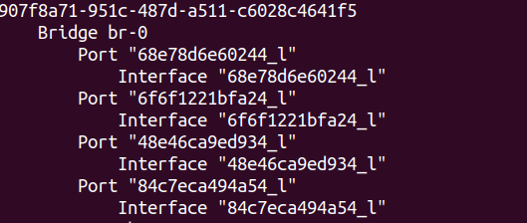
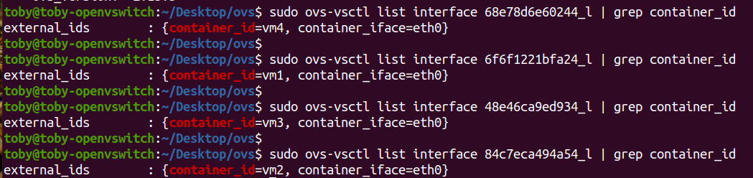
Find Port ID
sudo ovs-vsctl show
sudo ovs-vsctl list interface <ID>_l | grep container_id
  Ex : sudo ovs-vsctl list interface 68e78d6e60244_l | grep container_id

Slide 15
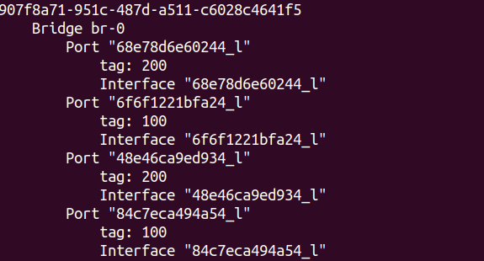
Configure Vlan
為 vm1 ~ vm4 設置 vlan
  sudo ovs-vsctl set port 6f6f1221bfa24_l tag=100
  sudo ovs-vsctl set port 68e78d6e60244_l tag=200
sudo ovs-vsctl show
.
.

Slide 16
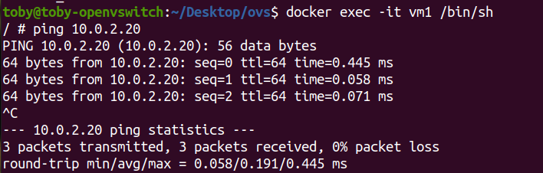
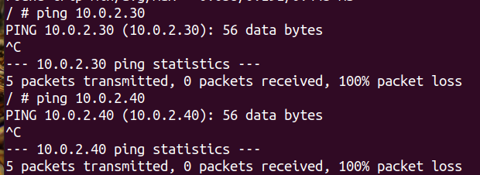
VM1 Test
進入 vm1 並測試
  docker exec -it vm1 /bin/sh
  ping 10.0.2.20 (vm2)
測試 vm3、vm4

Slide 17
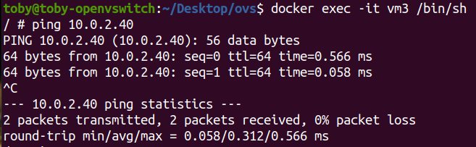
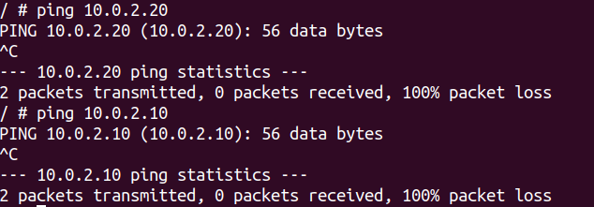
VM3 Test
進入 vm3 測試
  docker exec -it vm3 /bin/sh
  ping 10.0.2.40
測試 vm1、vm2

Slide 18
References
OvS Documentation :
  https://docs.openvswitch.org/en/latest/
The Design and Implementation of Open vSwitch :
  https://www.openvswitch.org/support/papers/nsdi2015.pdf
OvS Quick Install Page :
  https://installati.one/ubuntu/20.04/openvswitch-switch-dpdk/
OvS Vlan Example :
  https://docs.openvswitch.org/en/latest/howto/vlan/

